Slide 1


Introduction to git and GitHub
For Canepi! ☺

Slide 2
What will we cover?
What is Git and GitHub
General Git workflow
Setting up our own Git/GitHub accounts
Downloading/ cloning repositories (‘repos’)
Website vs locally
Uploading our own repo
Locally vs website

Slide 3
What will we cover?
What we need?
What is Git and GitHub
General Git workflow
Setting up our own Git/GitHub accounts
Downloading/ cloning repositories (‘repos’)
Website vs locally
Uploading our own repo
Locally vs website
Git – download
https://git-scm.com/downloads
GitHub account
https://github.com/
GitHub desktop
https://desktop.github.com/
Text editor
Atom - https://atom.io/ (preferable over Notepad ++)
Notepad ++ https://notepad-plus-plus.org/downloads/
3 ‘personal’ photos that you are happy to share and describe!
Think of 1 cartoon or animal.

Slide 4
Git
GitHub
Atom
GitHub desktop

Slide 5
What is Git and GitHub
Git is version control system (works locally on your machine).
GitHub is a centralised/ ‘cloud’ hosting service for Git repositories.

Slide 6
Benefits (and examples) of Git!
Git is version control system (works locally on your machine).
GitHub is a centralised/ ‘cloud’ hosting service for Git repositories.
Git (version control) is most useful for programmers!
So probably of less interest to yourselves.

Slide 7
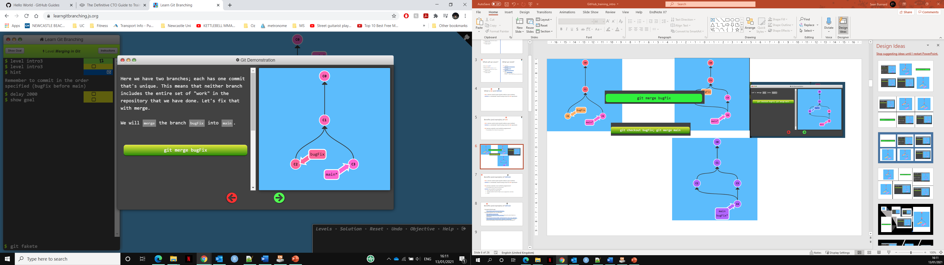
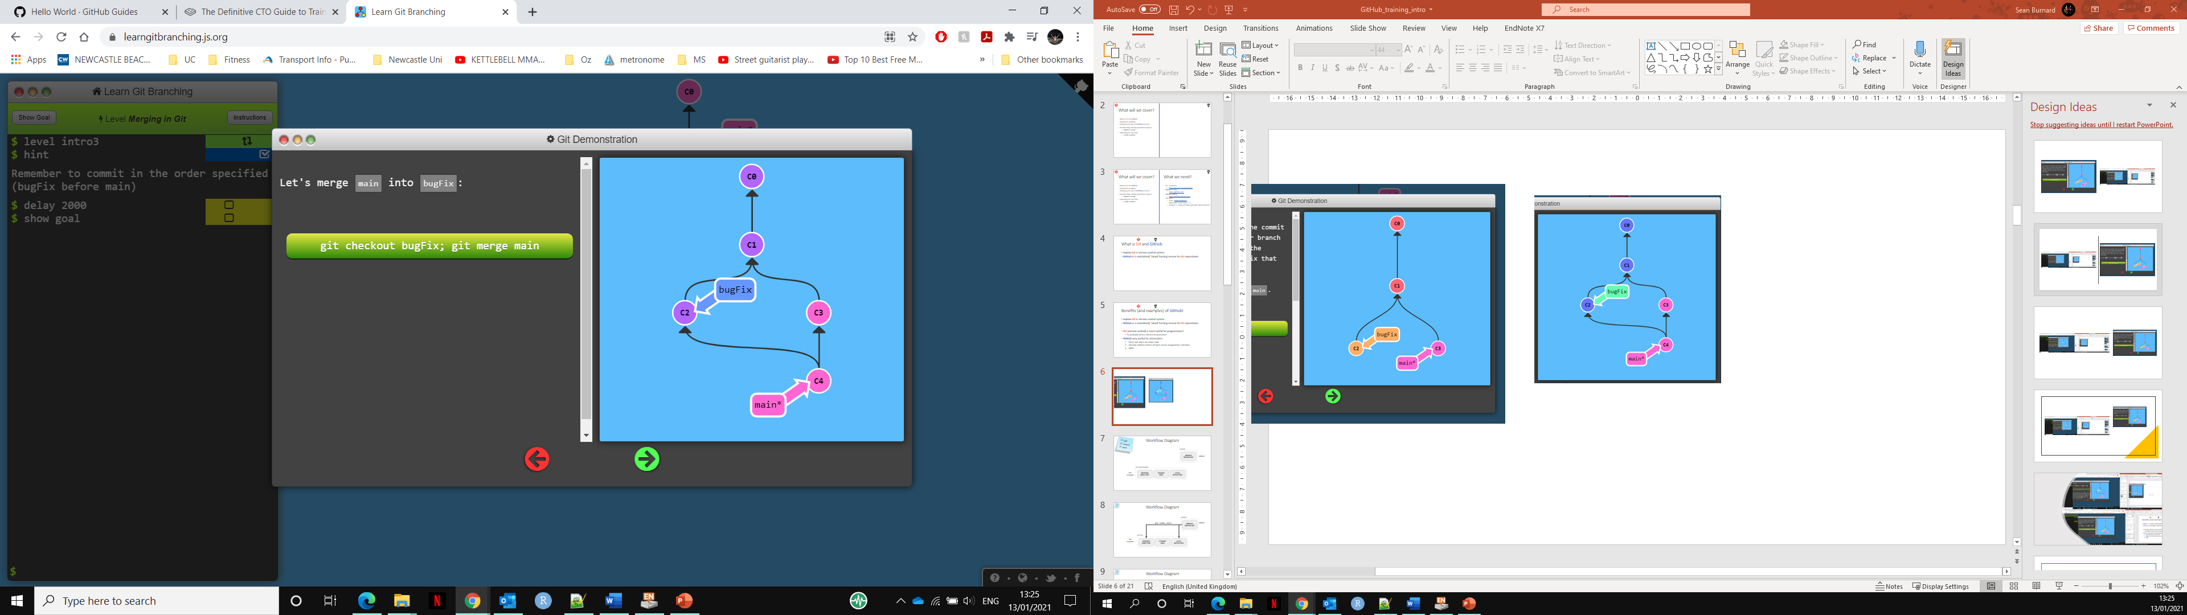
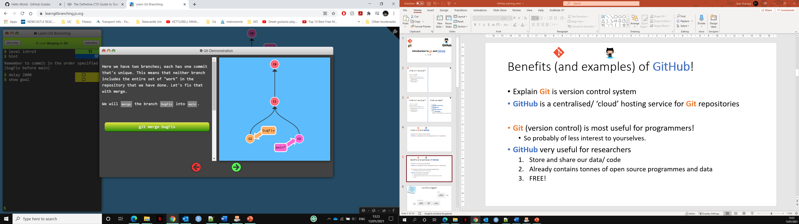
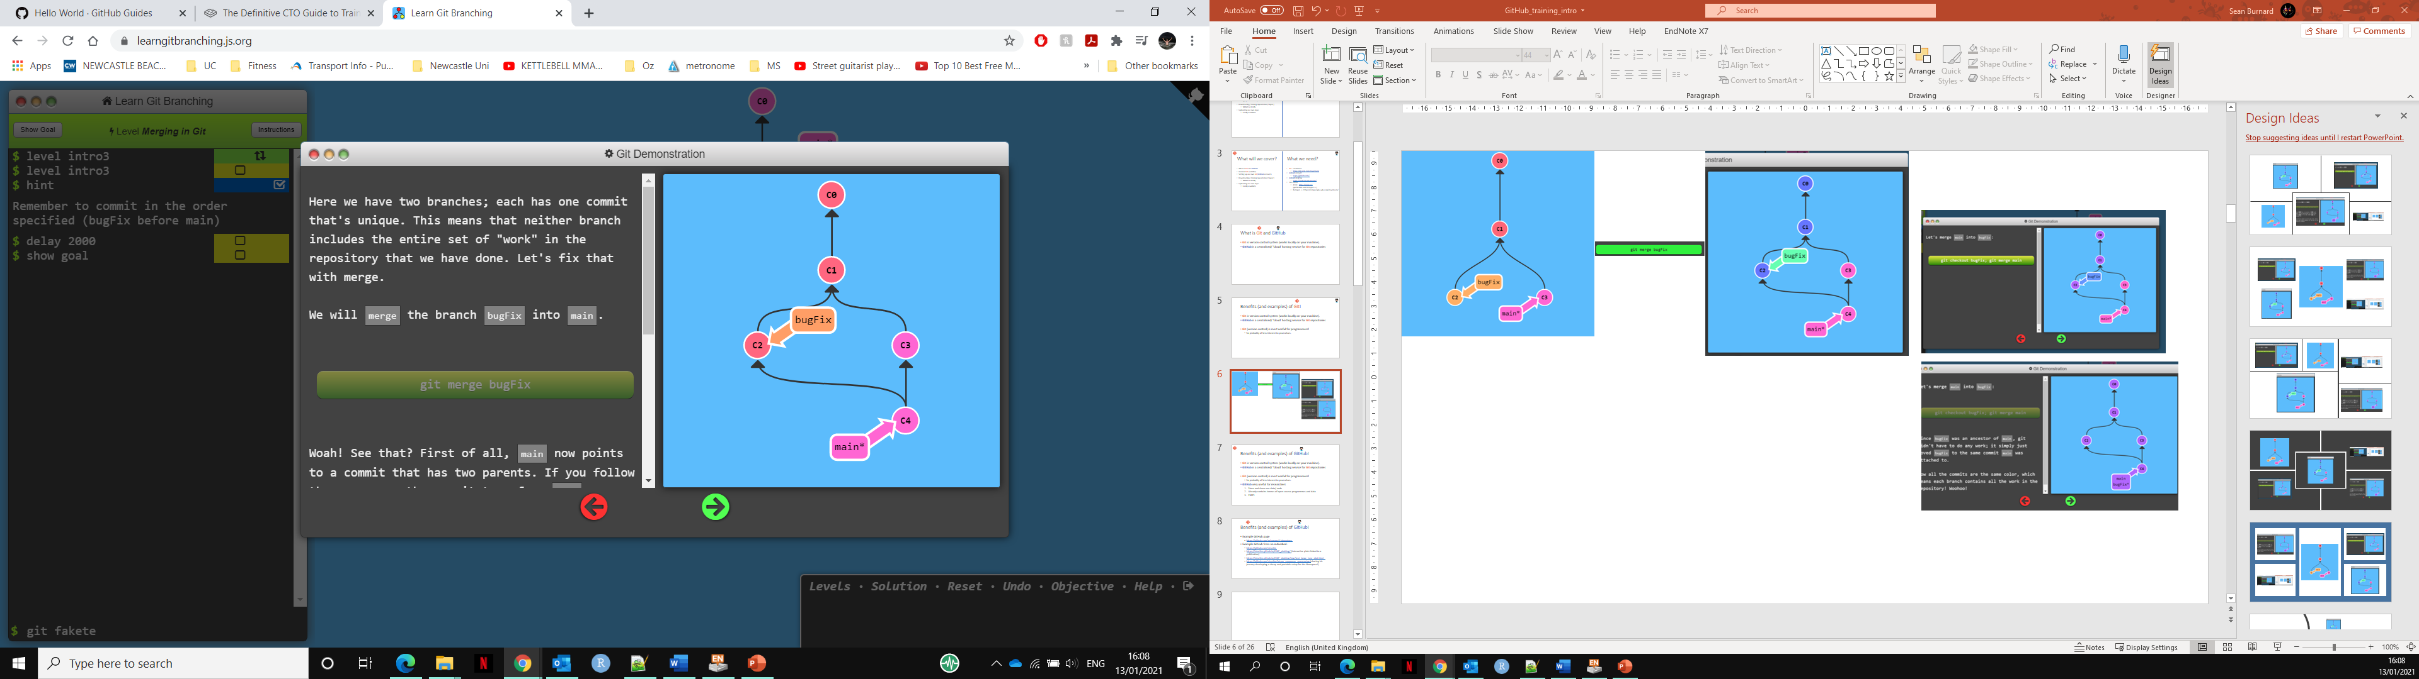
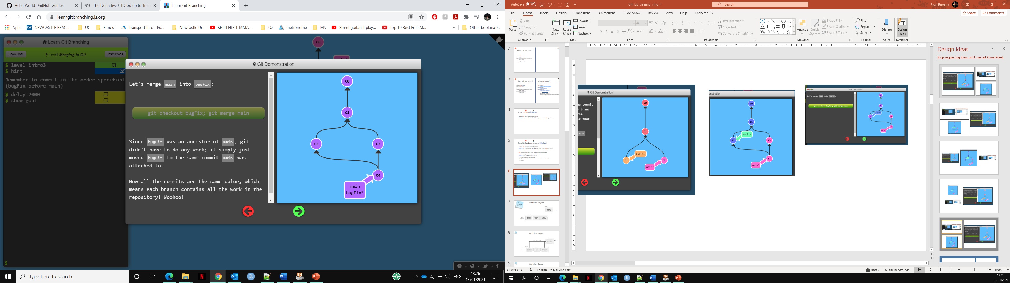
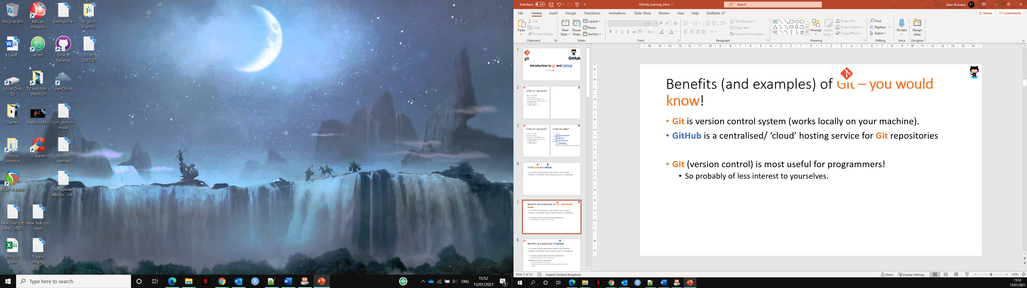
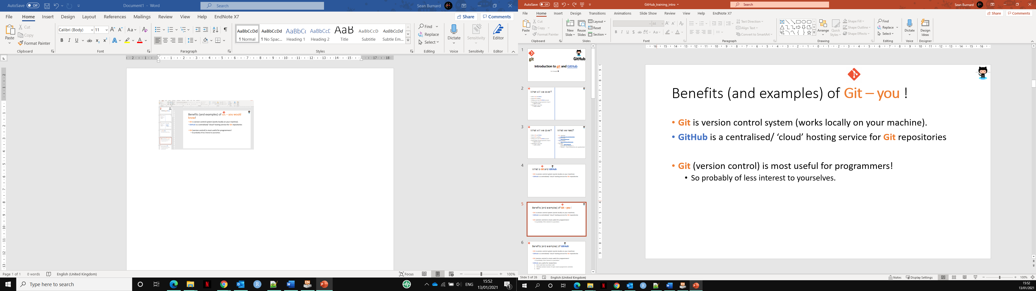
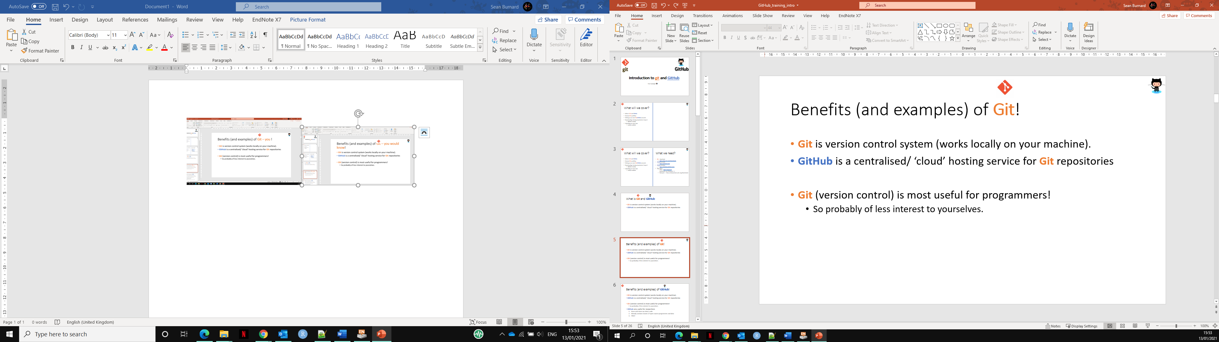
Example
Example of needing to return to an earlier version…
C3
C1
C0
Ctl z
Ctl z

Slide 8
Benefits (and examples) of GitHub!
Git is version control system (works locally on your machine).
GitHub is a centralised/ ‘cloud’ hosting service for Git repositories.
Git (version control) is most useful for programmers!
So probably of less interest to yourselves.
GitHub very useful for researchers
Store and share your data/ code
Access tonnes/ ‘heaps’ of open source programmes and data
FREE!
Versatile.

Slide 9
Benefits (and examples) of GitHub!
Example GitHub page from a lab group sharing software:
https://github.com/mhammell-laboratory
https://github.com/PMBio
Example GitHub page from an individual:
https://github.com/sirselim
Storing and sharing training:
https://github.com/PMBio/SingleCellCourse
Data and information for a publication:
https://github.com/PMBio/scNMT-seq
Easily create webpages:
https://learning-zone.github.io/website-templates/avenger-multi-purpose-responsive-html5-bootstrap-template/ (generic example template - see more https://github.com/learning-zone/website-templates )
https://sirselim.github.io/tSNE_plotting/ (Interactive plots on a webpage linked to a publication)
https://sirselim.github.io/tSNE_plotting/img/test_large_tsne_plot.html
Share your journey to promote a tool, generate interest and invite/ benefit from collaborative troubleshooting:
https://github.com/sirselim/jetson_nanopore_sequencing (his current journey developing a cheap and portable setup for the Nanopore!)
These are just a few ‘basic’ example uses of GitHub

Slide 10
https://learning-zone.github.io/website-templates/avenger-multi-purpose-responsive-html5-bootstrap-template/

Slide 11
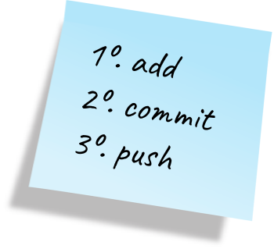
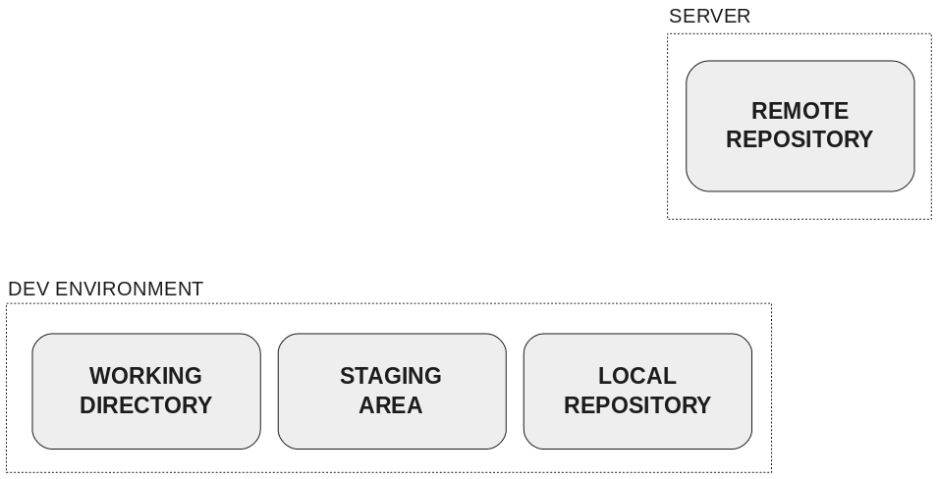
Workflow Diagram
GitHub
Our computer

Slide 12
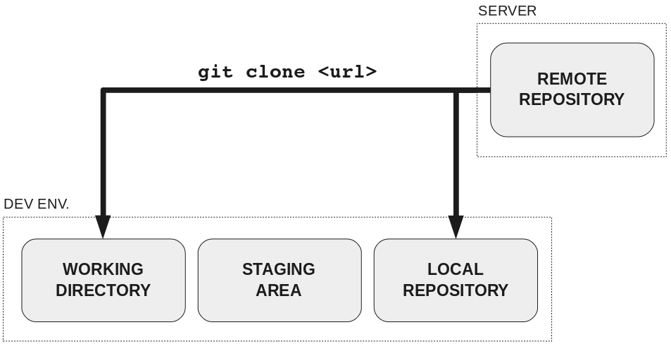
Workflow Diagram
GitHub
Our computer

Slide 13
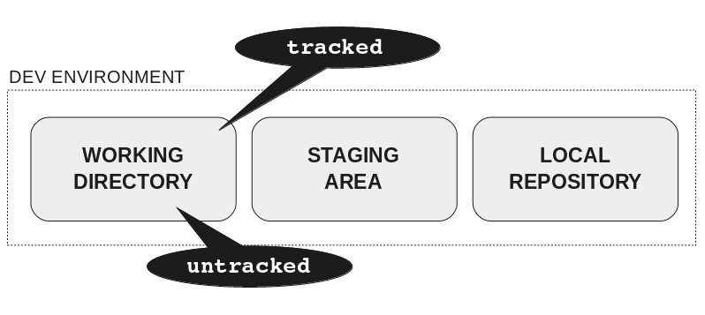
Workflow Diagram
GitHub
Our computer

Slide 14
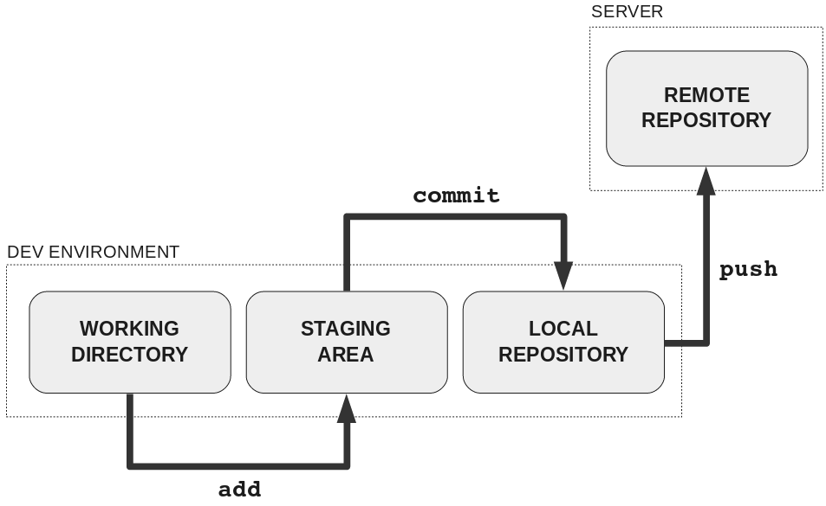
Workflow Diagram
GitHub
Our computer

Slide 15
Workflow Diagram
GitHub
Our computer

Slide 16
Workflow Diagram
GitHub
Our computer

Slide 17
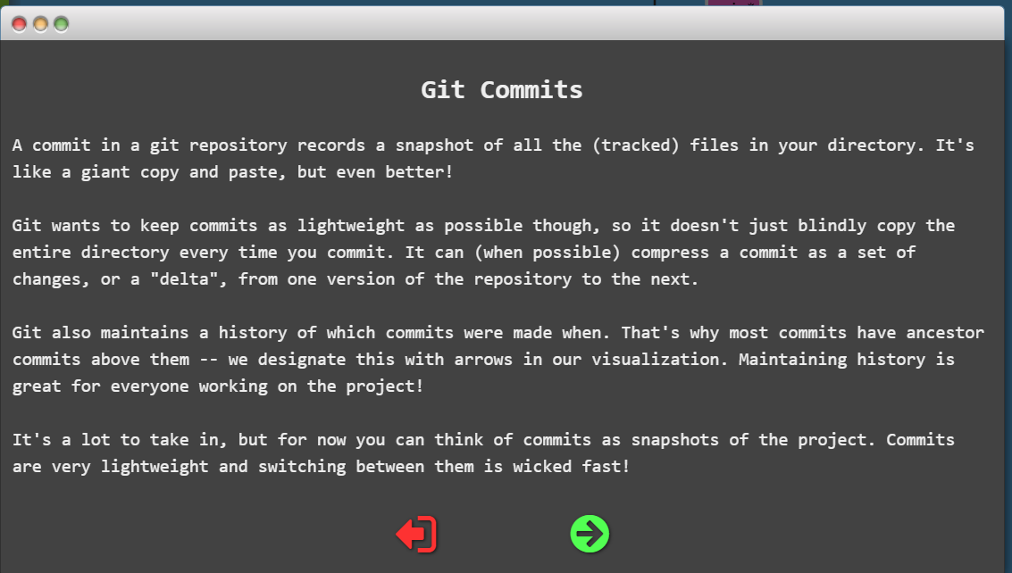
Workflow Diagram
GitHub
Our computer

Slide 18
Workflow Diagram
GitHub
Our computer

Slide 19
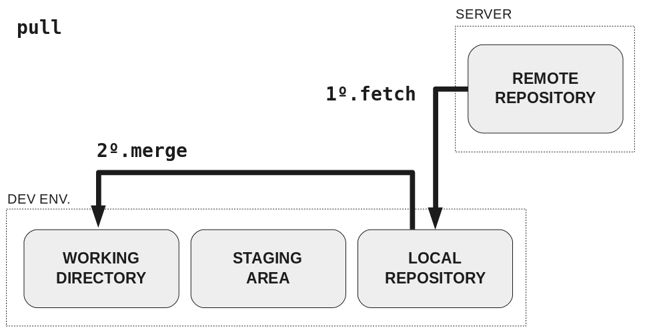
Workflow Diagram
GitHub
Our computer

Slide 20
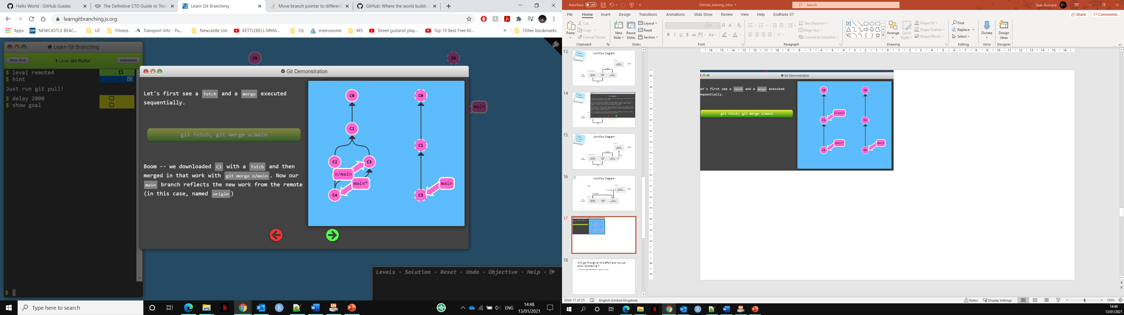
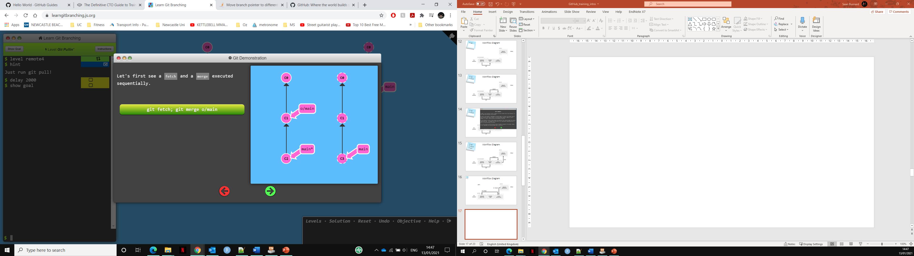
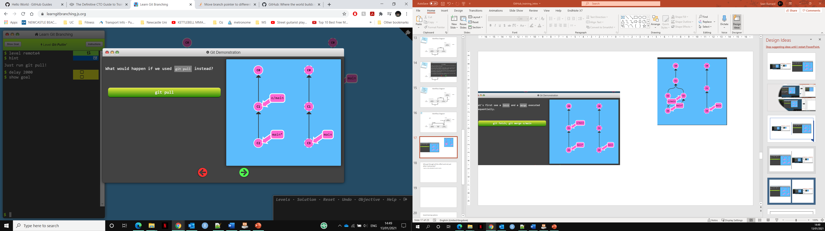

Slide 21
Practical 1 – make your own repo on GitHub
Make your own repo on GitHub
Clone it to your local machine!
Make some changes.
‘Commit’ and ‘Push’ it back to the GitHub page.
Activate the GitHub interactive page!
Have a looksie! ^^
https://docs.github.com/en/free-pro-team@latest/github/getting-started-with-github/create-a-repo

Slide 22
Practical 1
‘Fork’ my GitHub repo (Make my own GitHub page, containing 1) this training document and 2) a template to create an interactive )
This makes a copy in your GitHub account.
https://github.com/SBurnard/GitHubTraining
https://www.toolsqa.com/git/difference-between-git-clone-and-git-fork/
It is a better option to fork before clone if the user is not declared as a contributor and it is a third party repository (not of the organization)

Slide 23
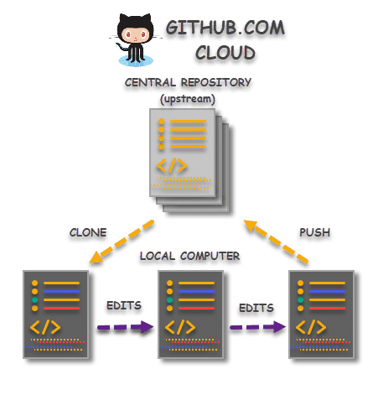
Exercise 1 – Direct upload to GitHub and edit (via command line)

Slide 24
Exercise 1 – simple rmd script
Create new repo
Upload file.
Edit in GitHub
Clone (command line)
Edit
Commit
Push
Check Github

Slide 25
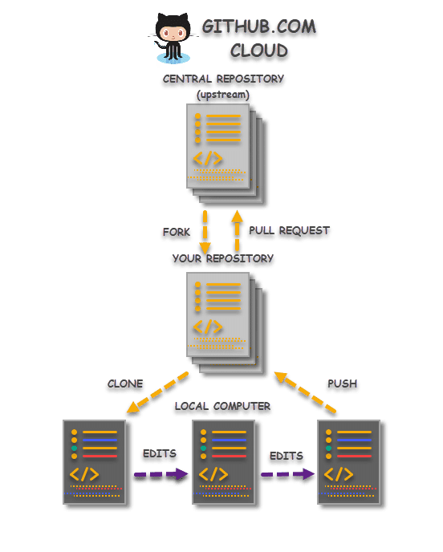
Exercise 2 – Fork, edit and upload your own website! (via GitHub desktop)

Slide 26
Exercise 2. Part 1
Locate the ‘Example_website_2’ repo in my GitHub page: https://github.com/SBurnard
‘Fork’ this repo to your own account (upper right screen)
‘Clone’ to your desktop, via GitHub desktop:
Click the arrow next to ‘current repository’
Add
Clone repository…
Either ‘filter for your repositories’ or use the ‘url’ to your repo! i.e. https://github.com/<your.user.name>/Example_website_2
Choose your local path (where to download it to)
‘Clone’ and wait!
Open this repo on the left bar.
Click ‘show in Explorer’. Have a look
Click ‘Open in Atom’. Have a look at the directories in the left bar and view the html and text files.

Slide 27
Exercise 2. Part 2
In the file explorer and /images/ directory, delete (or move) the three images (pic02,pic03 and pic04).
Locate your images, and change the name of your image names to: pic02.jpg, pic03.jpg and pic04.jpg
Drop these renamed images into the ‘images’ directory.

Slide 28
Why go through all this effort and not just allow ‘autosaving’?
Such as often defaulted in word or excel….

Slide 30
Good training options
From GitHub:
https://lab.github.com/githubtraining/prepare-to-use-github
https://lab.github.com/githubtraining/introduction-to-github
https://lab.github.com/githubtraining/first-day-on-github
Alternative sites:
https://blog.upperlinecode.com/how-to-teach-git-commits-github-to-teenagers-a3f740b2f500
https://rachelcarmena.github.io/2018/12/12/how-to-teach-git.html
https://towardsdatascience.com/getting-started-with-git-and-github-6fcd0f2d4ac6
https://learngitbranching.js.org/ (interactive for git)

Slide 31
OLD SLIDES

Slide 32
What will we cover?
What is Git and GitHub
General Git workflow
Setting up our own Git/GitHub accounts
Downloading/ cloning repositories (‘repos’)
Website vs locally
Uploading our own repo
Locally vs website
What we need?
Git – download
https://git-scm.com/downloads
GitHub account
https://github.com/
GitHub desktop
https://desktop.github.com/
Text editor
Atom - https://atom.io/ (preferable over Notepad ++)
Notepad ++ https://notepad-plus-plus.org/downloads/

Slide 33
What will we cover?
What is Git and GitHub
General Git workflow
Setting up our own Git/GitHub accounts
Downloading/ cloning repositories (‘repos’)
Website vs locally
Uploading our own repo
Locally vs website

Slide 34
Benefits (and examples) of GitHub!
Example GitHub page from a lab group sharing software:
https://github.com/mhammell-laboratory
Example GitHub page from an individual:
https://github.com/sirselim
https://sirselim.github.io/tSNE_plotting/ (Interactive plots on a webpage linked to a publication)
https://sirselim.github.io/tSNE_plotting/img/test_large_tsne_plot.html
https://github.com/sirselim/jetson_nanopore_sequencing (sharing his journey developing a cheap and portable setup for the Nanopore!)

Slide 35
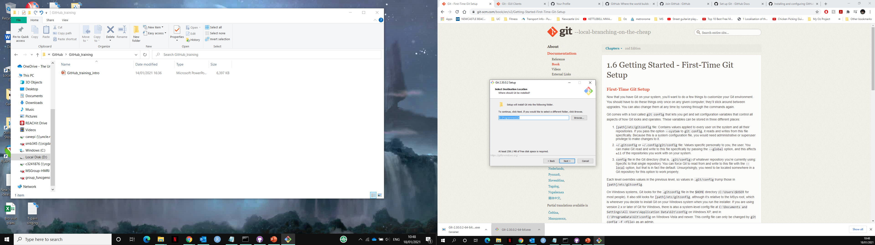
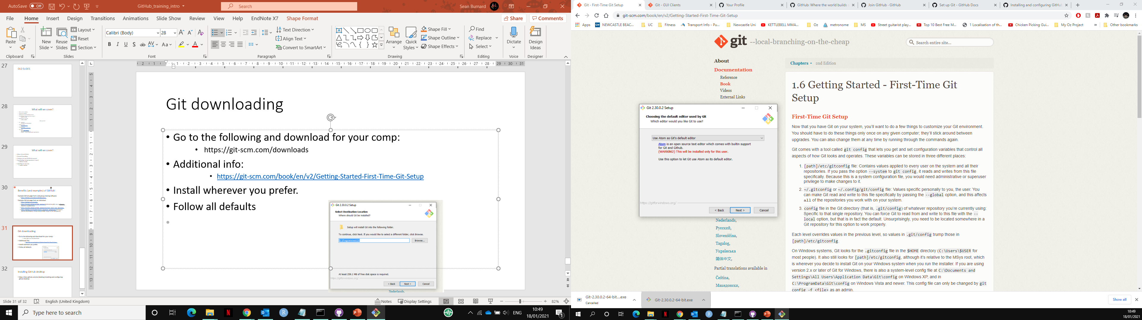
Git downloading
Go to the following and download for your comp:
https://git-scm.com/downloads
Additional info:
https://git-scm.com/book/en/v2/Getting-Started-First-Time-Git-Setup
Keep all defaults apart from ‘editor used by git’:
Choose notepad++ or Atom

Slide 36
cd Documents
mkdir Git_Test
cd Git_Test/

Slide 37
https://learning-zone.github.io/website-templates/add-life-health-fitness-free-bootstrap-html5-template/
https://sburnard.github.io/Example_website/
https://towardsdatascience.com/launch-a-website-for-free-in-5-simple-steps-with-github-pages-e9680bcd94aa
https://html5up.net/

Slide 38
Installing GitHub desktop
https://docs.github.com/en/desktop/installing-and-configuring-github-desktop

